Slide 1



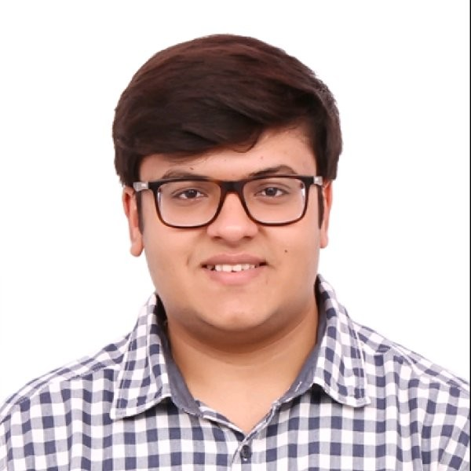




Speaker
Arsh Sharma & Madhav Jivrajani
Making Your Controllers Resilient: Workqueue To The Rescue
Arsh Sharma
Madhav Jivrajani
RinkiyaKeDad
MadhavJivrajani
September 16th & 17th
^{Online Event}
Powered By
International Conference

